Slide 1
Prediction 1
Jason Woo

Slide 2
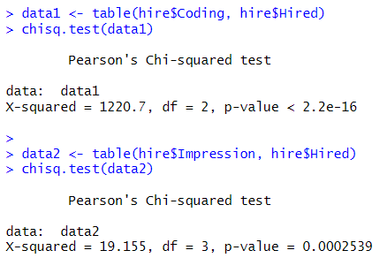
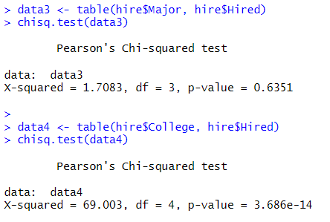
Chi-Sq Test
Using the chi-sq test, we can determine the relationship of variable to our predicted (Hired) column
We can use p-value to determine whether that role is more likely to play a role in our prediction model
Considering these p-values, we see that the Major column is less influential in playing a role with a p-value of 0.6351

Slide 3
Method
I will build my prediction model around the idea of the chi-sq test, so less of using the major column will probably be best
I will also try to subset data and select most frequent values of the predicted variable as my prediction
Trial and error will be the main incentive for my prediction model

Slide 4
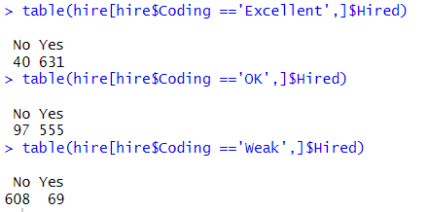
Distribution of Hired by Coding Skill
We can generalize the coding skills column to see which stands out to us, and which we can use for our prediction model
It overall seems explanatory with excellent and OK being most hired, so we can generalize the two
Ill assign my prediction model based on these facts for now

Slide 5
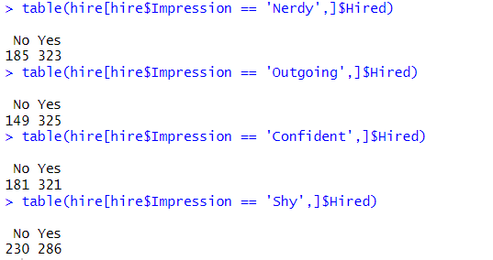
Distribution of Hired by Impression
Here, we look at the impression column and see if any of the variables stick out
To me none of these stick out, but we can subset further
We can subset impression and college together, however we will only look at impressions of “Nerdy”, “Outgoing”, and “Confident” since they are the most frequent variable

Slide 6
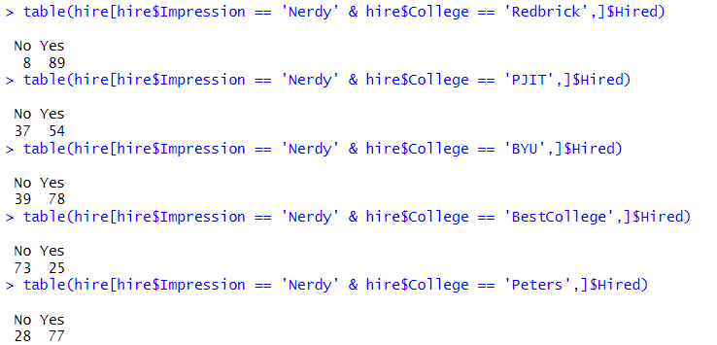
Distribution of Hired by Impression and College Pt. 1
We subset the Impression column with its respective college and we find the frequency of those who are hired
For the specific slide, we will look at when the impression is “Nerdy”, and we see that it is most frequent for someone with a Nerdy Impression went to college at Redbrick
Let's assign it to our prediction for now

Slide 7
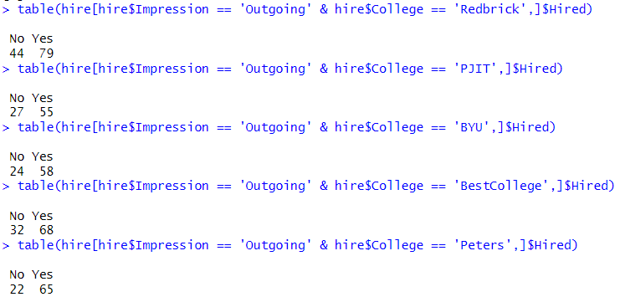
Distribution of Hired by Impression and College Pt. 2
Now, we look at the distribution of those who were hired when they had an “Outgoing” impression
While looking at those who were hired, I wanted to also see who was not hired the least, which would contribute to a lower error in difference for the prediction model
To me, those who went to Peters showed a decent amount of people who were hired, while also having low frequency of being not hired

Slide 8
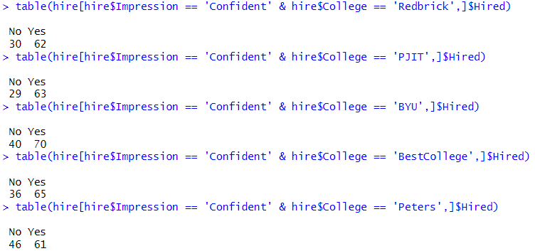
Distribution of Hired by Impression and College Pt. 3
Lastly, we must look at those who shown a “Confident” impression
Same applies from Pt 2. where we look at high frequencies of hired while also keeping low frequencies of those not hired
The college PJIT is best fit for this model

Slide 9
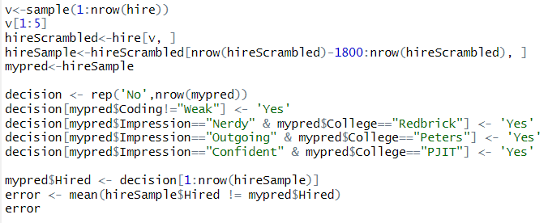




Cross-Validation
I used 200 rows to test the error
I conducted the test several times and got pretty good error values

